Slide 1
UNIVERSITY INSTITUTE OF COMPUTING
Bachelors of Computer Application
Project
Made Setup
An Overview
of Computing
&
Career Planning
Student Name: Dhruv Jindal
UID : 22BCA10288
Section/Group: 22BCA-3A
Supervisor Name: Jasleen Kaur
Employee Code: E16528
Designation: Professor
DISCOVER . LEARN . EMPOWER

Slide 2
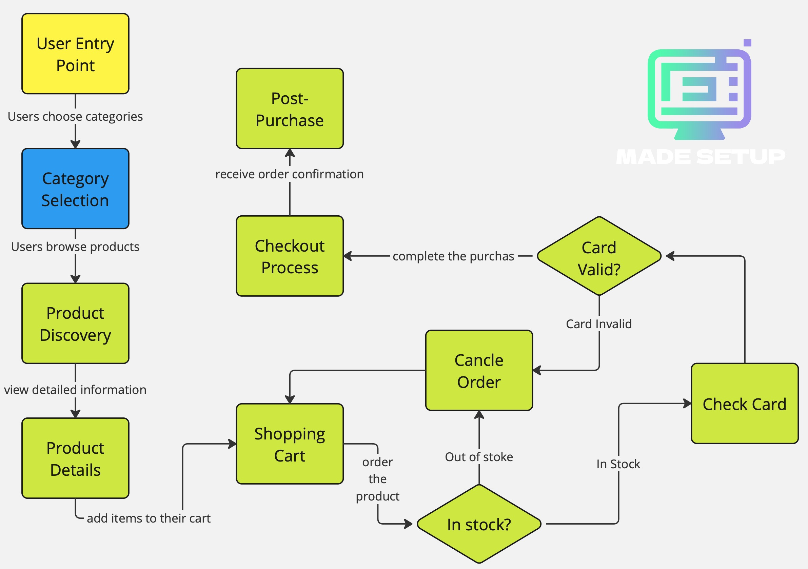
Block Diagram

Slide 3
Experimental setup and Design
Prototyping:
Built prototype with HTML, CSS, JS, and Bootstrap.
Integrated APIs for location and payments.
User Testing:
Tested with gamers, designers, and office users.
Gathered feedback on experience and navigation.
Design Refinement:
Improved UI/UX based on feedback.
Ensured responsiveness across devices.
Performance Metrics:
Tracked KPIs like load time and conversion rates.
Optimized backend for better performance.

Slide 4
List of required Equipments &Software
Hardware:
Workstations: High-performance PCs.
Servers: For website hosting.
Testing Devices: PCs, tablets, smartphones.
Software:
Development: VS Code, Git/GitHub.
Design: Adobe XD/Figma, Photoshop.
Frameworks: Bootstrap, SwiperJS.
Database: MySQL.
APIs: Google Maps, Payment Gateway.

Slide 5
List of required Equipments &Software
3. Testing & Analytics:
Analytics: Google Analytics.
Project Management: JIRA/Trello.

Slide 6
Research Methodology
The research methodology is planned to know and understand the different objectives of the study on E-commerce.
In this particular study, Analysis Method is used to systematically collect, evaluate, analyse and summarize the results from a number of respondents.
Sample size is limited to 50 respondents in which some are business persons, service holders, self employed persons, college students and some are working women belonging to different age groups.

Slide 7
Research Methodology
The tools and techniques used for analyzing data are statistical tools.
These tools are applied to describe the data scope, modularize the data structure, condense the data representation, illustrate via charts, tables and graphs, and evaluate statistical inclinations, probability data, to derive meaningful conclusions.

Slide 8
Objective of project
To understand the different models of E-commerce.
To find out the awareness and usage of E-commerce among customers of different age group.

Slide 9
THANK YOU

